Slide 1
Sketching, Low-fi Prototyping & Pilot Usability Testing
Assignment 5
Grace Miller, Ginelle Servat, CJ Indart, Riley Pittman

Slide 2




Our Team
CJ Indart
Ginelle Servat
Grace Miller
Riley Pittman

Slide 3

Students connecting for shared success

Slide 4
Novelty of our Application
The Problem
Our Solution
Students searching for jobs and post-graduate career options often feel isolated or alone
Connect students with similar interests to form community groups where they can appreciate and support each other

Slide 5
Agenda
Sketching Explorations
Interface & Rationale
Low-fi Prototype
Task Flows
Testing Methodology
Testing Results
Implications
Appendix

Slide 6
Sketching Explorations

Slide 7
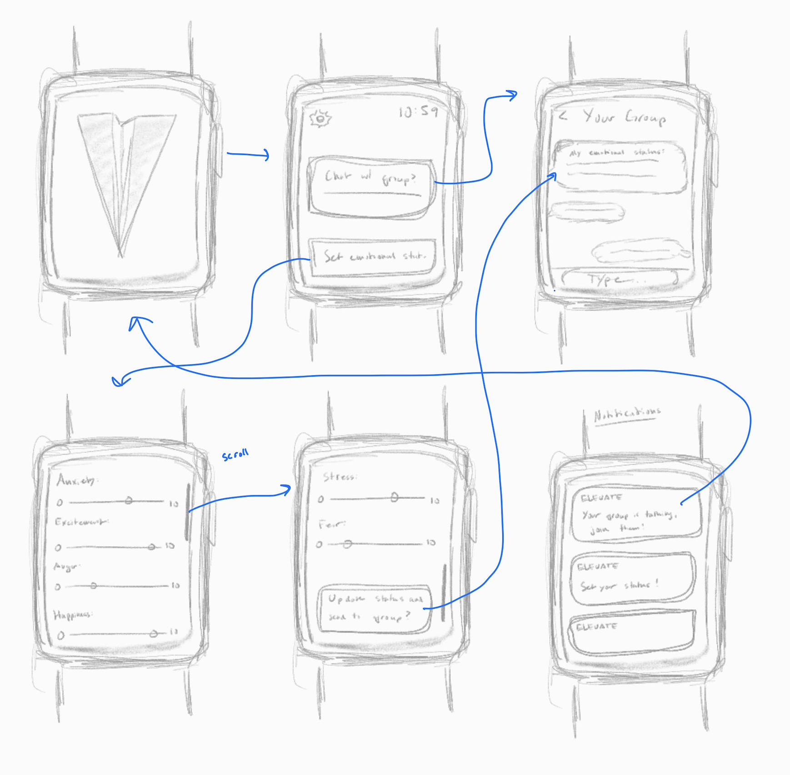
Concept 1: Apple Watch

Slide 8
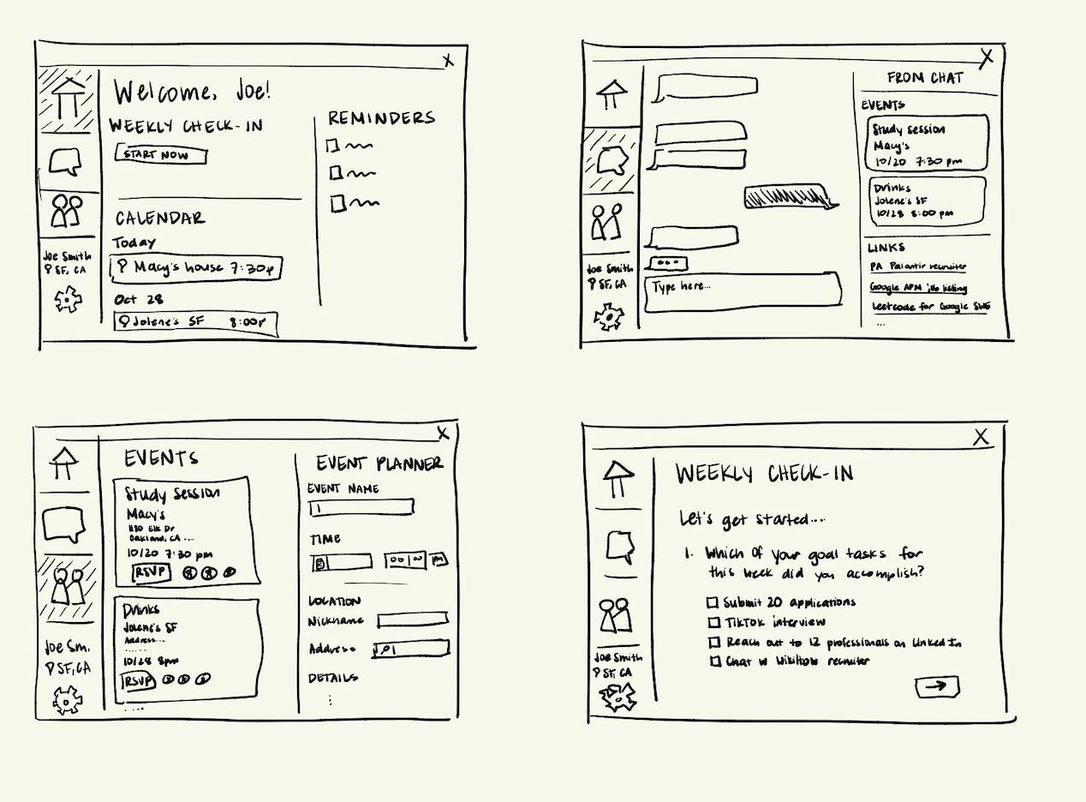
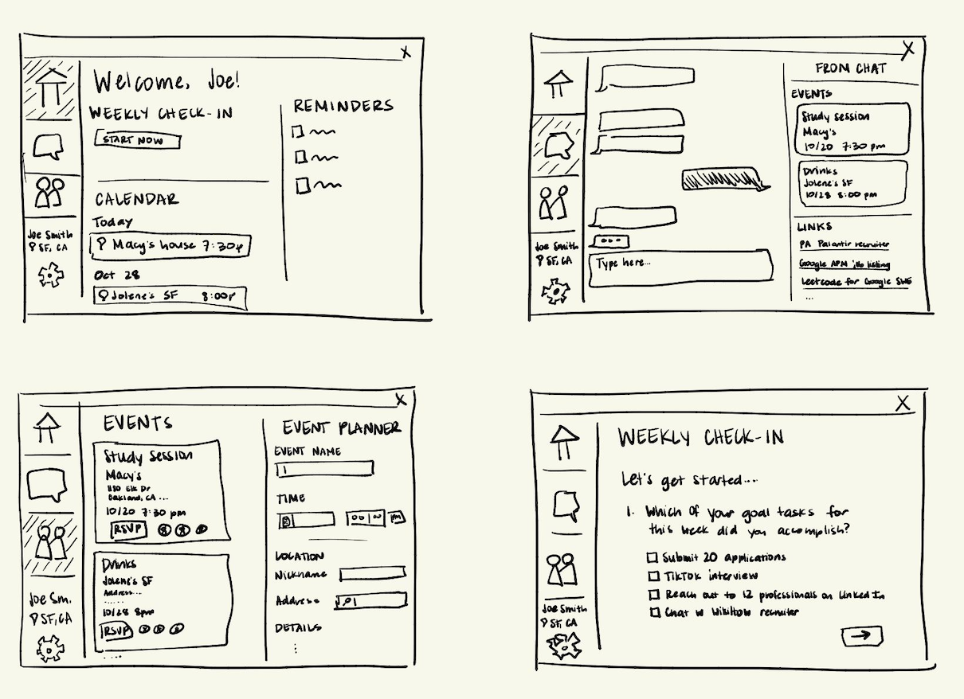
Concept 2: Desktop

Slide 9
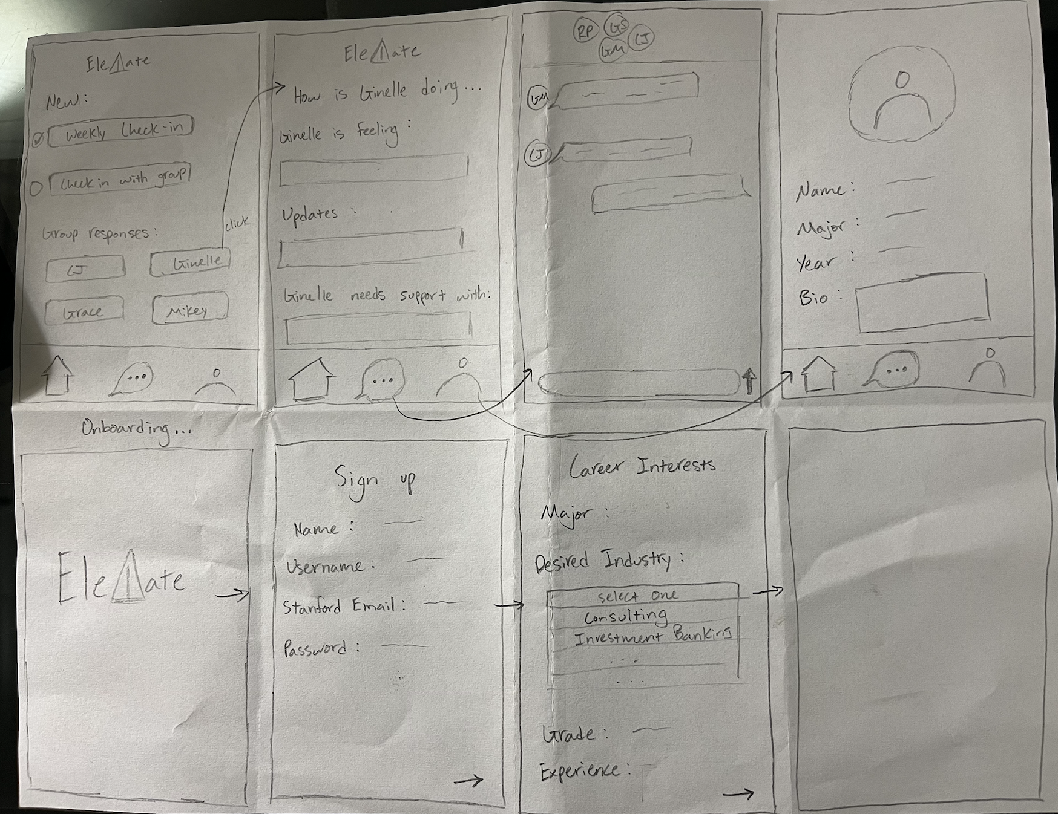
Concept 3: Mobile App

Slide 10
Top 2 Realizations

Slide 11
Desktop
Pros
Cons
More screen space allows expanded interfaces for functionalities like goal planning
Makes it easier for users to share content like files and links
Easier for users to access professional resources on their laptop
Messaging/communication features are harder to keep up with
Users may open or use the app less often
More screen space could encourage an unnecessarily complicated UI for tasks that could be simple

Slide 12
Mobile App
Pros
Cons
Makes messaging and communication on the app intuitive
Users are more likely to open and use the app frequently
Notifications can be used to support goal-setting, reminders, and deadlines
Small screen restricts options for UI and functionality
Chat function needs to be strongly differentiated from phone messages to justify chatting on-app

Slide 13
Selected Interface

Slide 14
Mobile App

Slide 15
Rationale
Consistent use of our app helps accomplish our task goals
Familiarity with mobile communication optimizes supportive interactions
Notifications complement deadline, scheduling, and wellness check-in functions

Slide 16
Low-fi Prototype

Slide 17
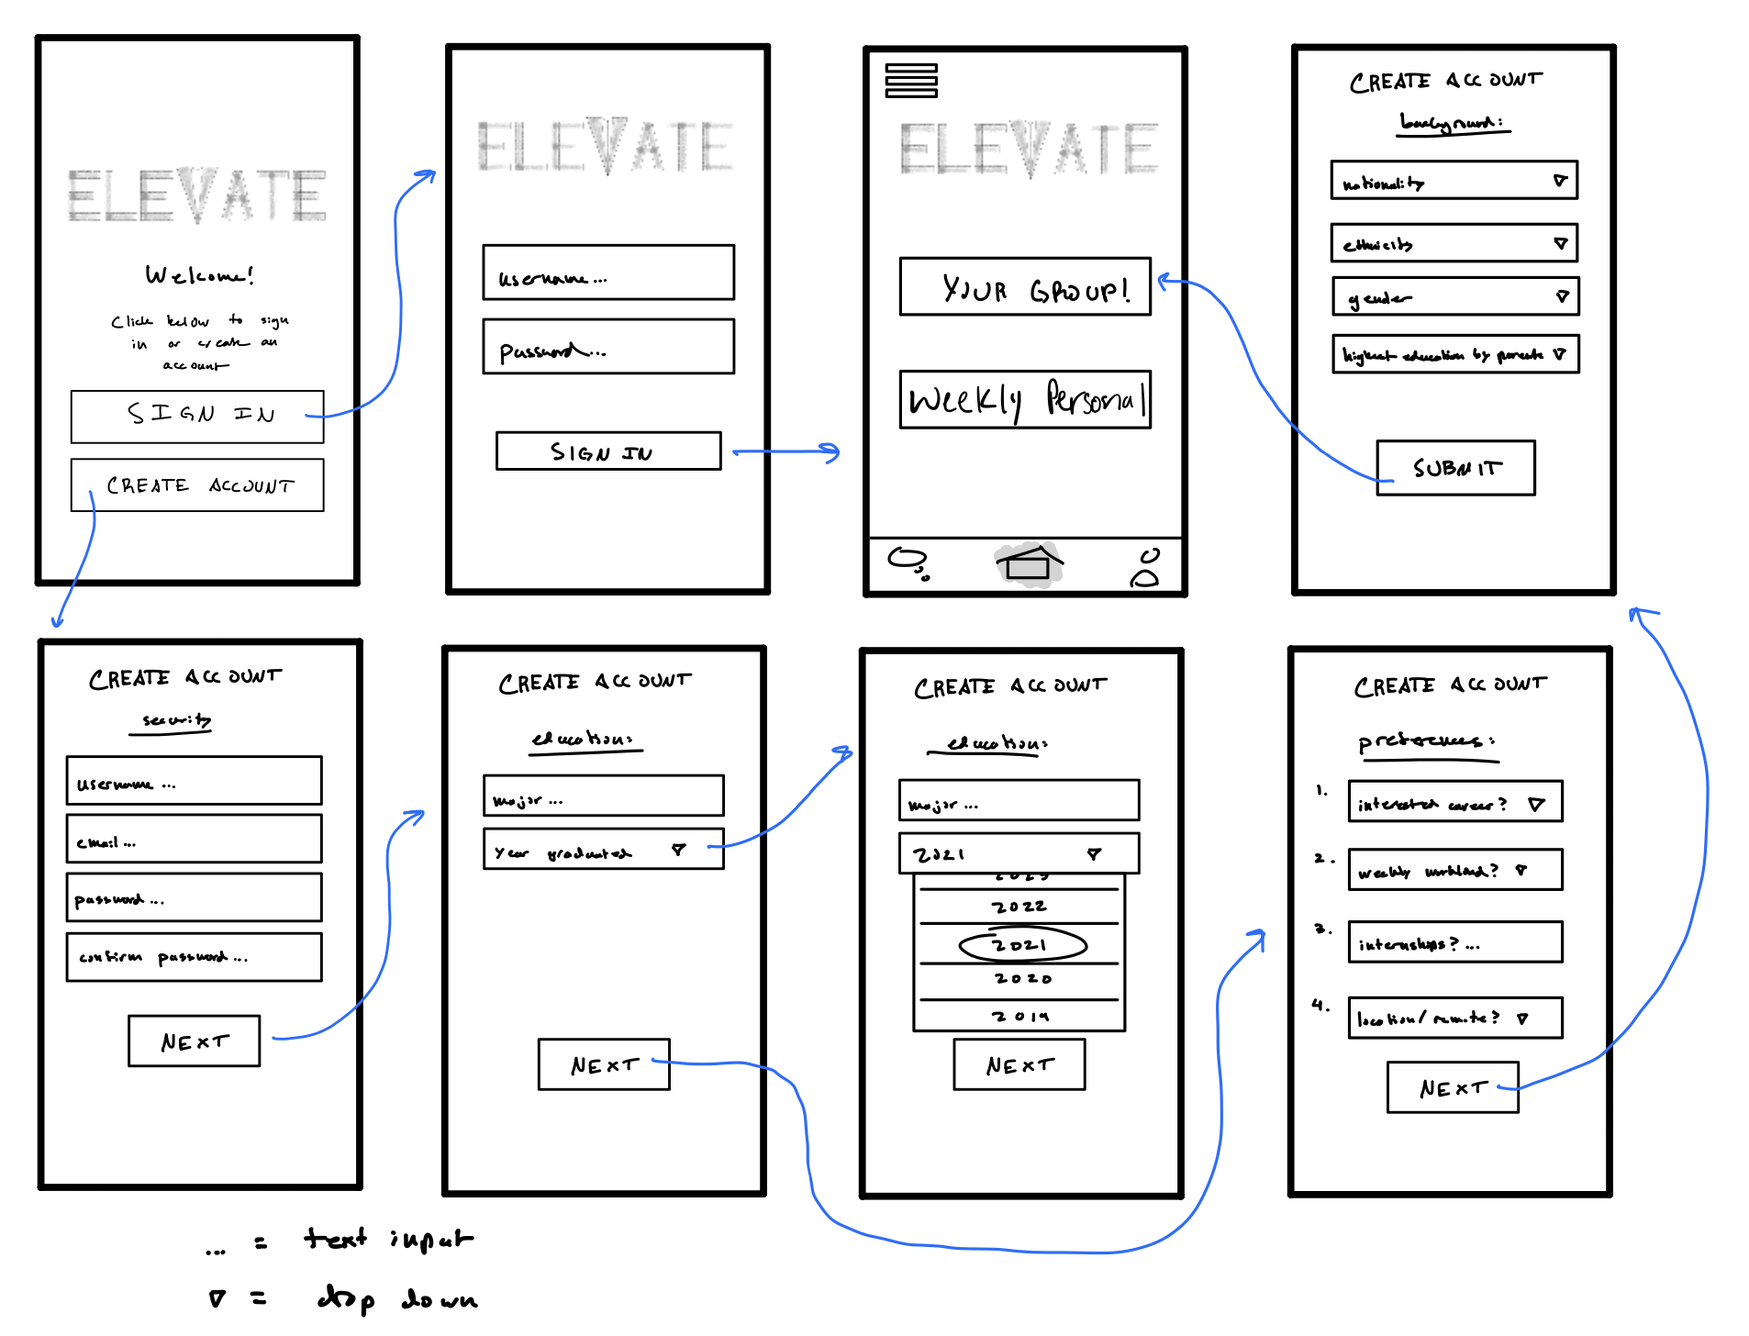
First-time users are prompted to give their interests

Slide 18
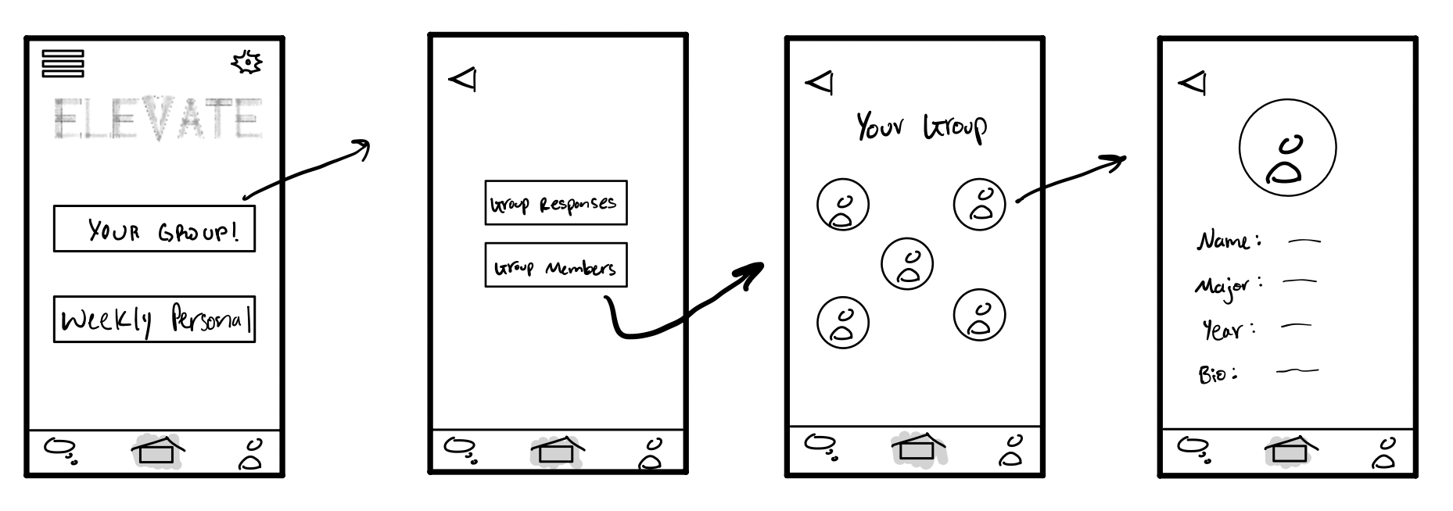
Once matched, check out group members

Slide 19
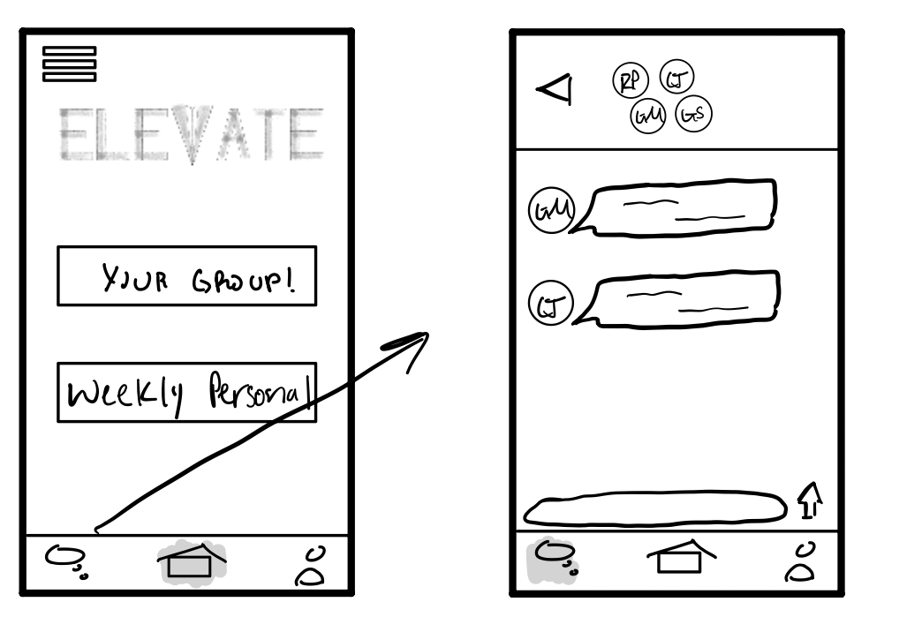
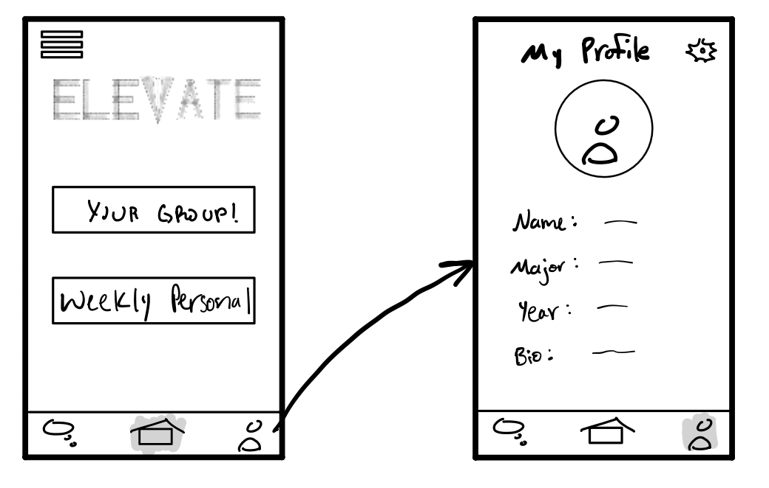
Chat with group members
Customize your profile

Slide 20
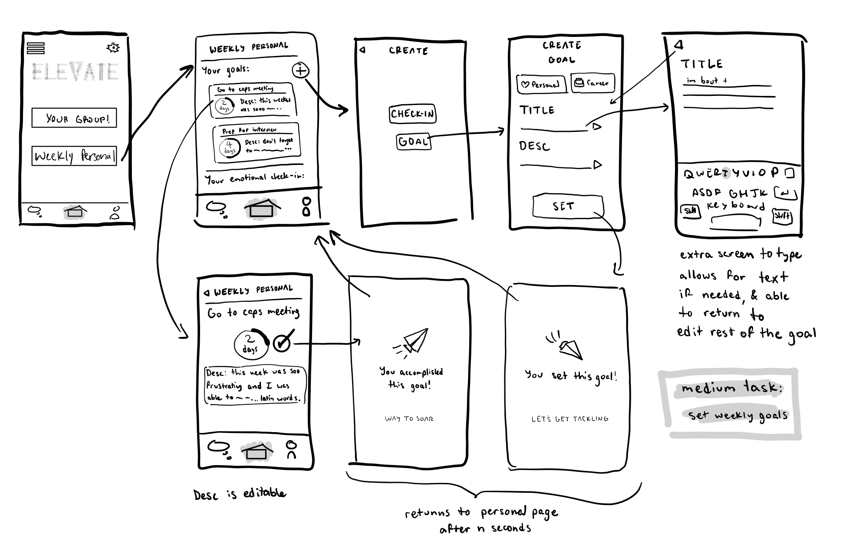
Set weekly goals

Slide 21
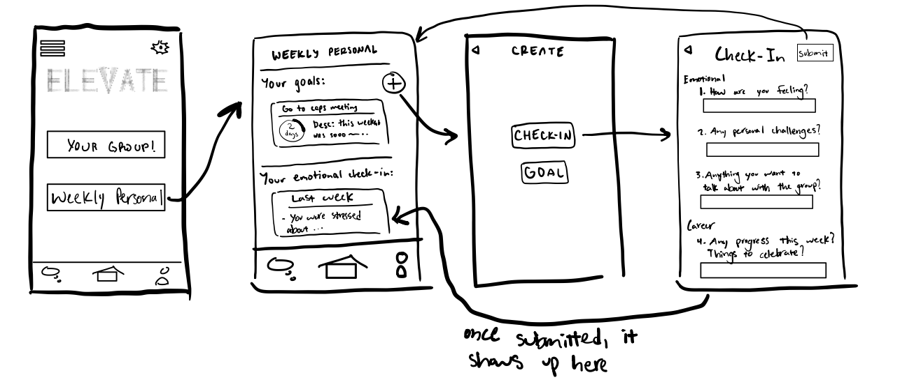
Fill out weekly check-in forms

Slide 22
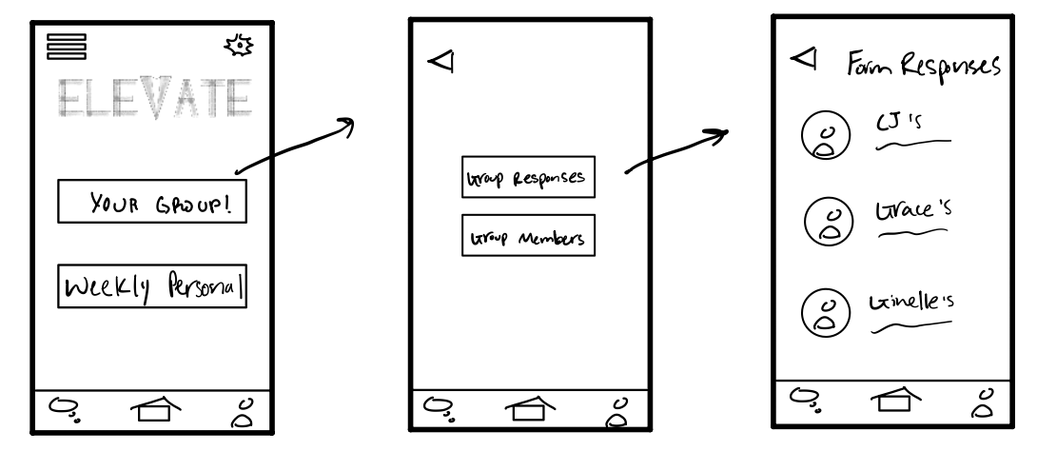
See other members’ weekly check-in responses

Slide 23
Task Flows

Slide 24
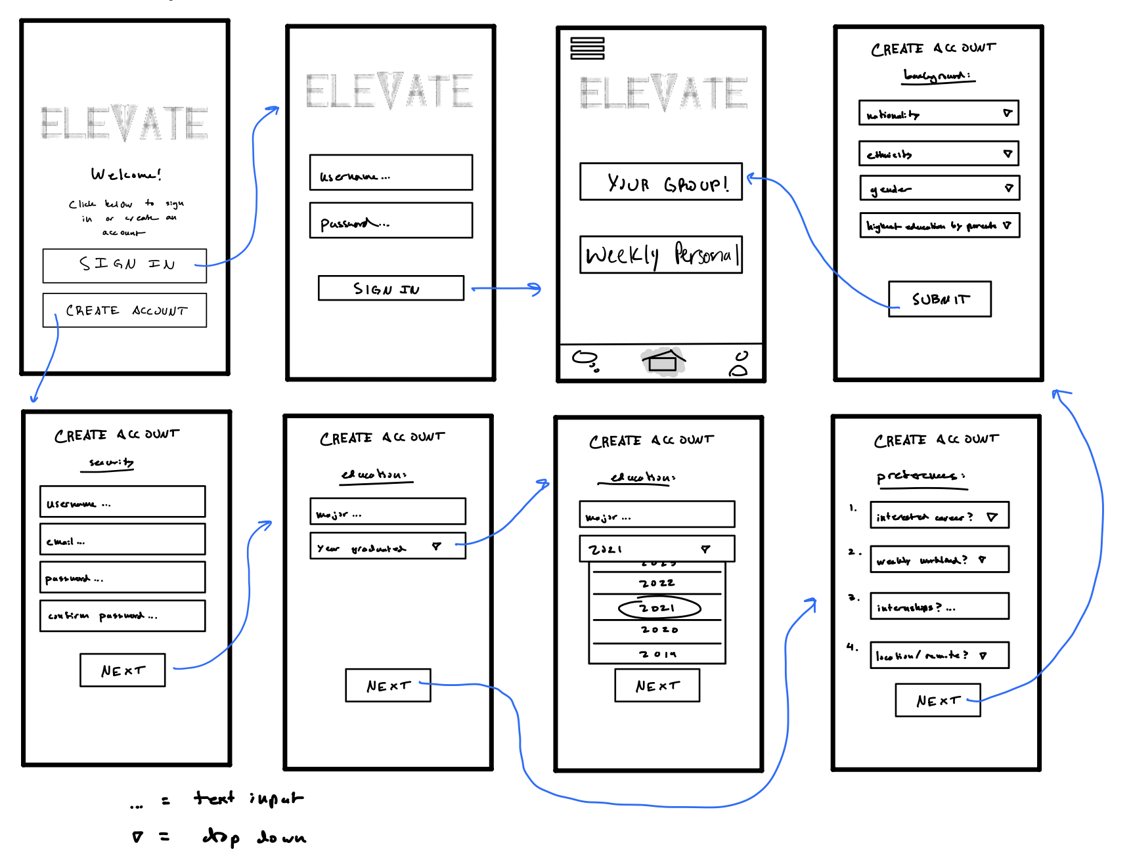
Simple: match with other users of similar interests

Slide 25

Moderate: set weekly goals

Slide 26
Complex: participate in weekly emotional and job search check-ins

Slide 27
Testing Methodology

Slide 28
Users
Matthew
Sarah
Age 26, friend of a sibling, no compensation
Age 22, Stanford undergrad student, no compensation
Kath
Liz
24, friend of a sibling, PhD student at UCSC, no compensation
23, friend of a sibling, PhD student at UCSC, no compensation

Slide 29
Environment and Apparatus
Laid out every page of the low-fi prototype
One screen per page
Took place on a large table

Slide 30
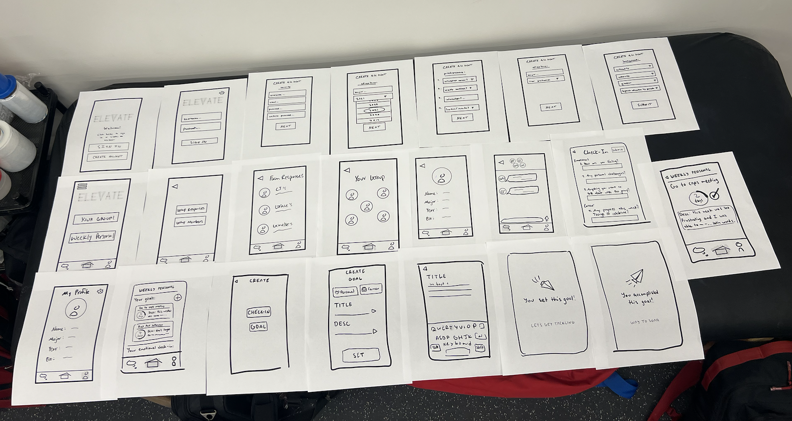

Slide 31
Team Member Roles
CJ
Note-taker
Ginelle
Note-taker
Grace
Computer
Riley
Facilitator

Slide 32
Procedure
Gave users some basic context behind Elevate
Brief demo of the system
Took notes as users completed each task
  They were asked to think out loud

Slide 33
Procedure
Asked the users the following questions:
  Were there any features that were unclear? Not useful?
  How was the UI in ease of use?
  General feedback?
  On a scale from 1-10, how likely are you to use the chat feature? How about the weekly check-in forms? And the goal setting?

Slide 34
Usability Goals and Their Measurements
Intuitive UI
Likelihood To Use Feature
Measure the number of mis-clicks
Participants rate how likely they are to use feature from 1-10
Notes:
Sharon conducted in person??

Slide 35
Testing Results

Slide 36
Process Data - All Participants
Unaware they were paired into a group after onboarding
Had difficulty finding where to do the weekly check-in
Found it difficult to know all functionalities of the app from the home page
Found the UI to be mostly intuitive

Slide 37
Process Data - Other Takeaways
2 participants clicked on the profile button to get to personal goals
2 participants thought members’ responses were in the chat page
Need to think about what happens if users don’t get along with group members
All got the simple and moderate tasks, and took longer to complete the complex

Slide 38
User Feedback
“What if I want to connect with one specific person in the group?”
Need a back button on the weekly personal screen
Users might not want to fill out the background questions in onboarding

Slide 39
Usability Goals and Their Measurements
Intuitive UI
Likelihood To Use Feature
Measured 5 mis-clicks
Main features earned ratings of 6-8, none below 5

Slide 40
Implications

Slide 41
What Testing Couldn’t Reveal
How much groups would use the chat feature
How satisfied users would be with their groups
Impact on mental health

Slide 42
Implications
Users expect more visibility and control over group creation
Users expect to be able to communicate independently, not just in a group chat
Task flow details need refining, particularly weekly check-in and goal creation and checkoff

Slide 43
Changes We’ll Make
Rethink weekly check-in task flow, especially where to begin completing the form
Make group sorting process more visually clear to the user; possibly involve the user more
Give users more control over and individual communication with the members of their group
Put more thought into introductory questions on signup

Slide 44
Thank you!

Slide 45
Appendix

Slide 46
Testing Results
First user:
  didn’t know he was matched at first
  Asked how to connect with one person
  Took a second to recognize the plus sign used to create goals or do the check in
  What if he only wants to stay connected to one group member and he doesn’t like the others? He wanted to connect with one person
  Hard to know he can create a goal from home
  Only error was initially clicking on the chat page to get to group members’ responses

Slide 47
Testing Results (continued)
Tester Sarah:
- Participant completed all tasks with minimal error
- didn't know when to mark that the first task ended
- longest delay/confusion in the plus sign symbol in the personal weekly for creating a check-in
- Unsure about sharing certain information at different points in the app
- At matching sign-up and account creation:
- drop down inconsistency/misclicking
- confused by section names
- preferences questions didn't feel clear enough to tester and raised confusion
- background questions resulted in "prefer not to answer"
- At weekly check-in:
- Q's 2-3, "not really," "no."
- Suggested collapsible segments for people who didn't make progress or clear goals that week

Slide 48
Testing Results (continued)
Tester 1 (Kath)
Measurements:
-number of confusion points
> class year
>didn’t realize the checkpoint on close up goal was clickable bc it was already checked
>couldn’t find where to start weekly check-in
> need back arrow on weekly personal screen
-errors
> tried to navigate to personal goals thru personal tab of menu
> tried to click on emotional check-in to get to check-in form
> hit goal to try to get to weekly check-in form
> tried to go to chat to get to members’ responses
Tester 2 (Liz)
-number of confusion points
>didn’t realize she was sorted into a group
>thought bubble should be a speech bubble (couldn’t find the chat because of it)
>couldn’t find weekly check-in (went to group first, then didn’t know what to do from weekly personal)
-errors
>clicked self icon in menu bar to try to get to personal goals
>went to group to try to find weekly check-in
-notes
>did get correct for marking goal accomplished (didn’t confuse bc of check)
>used home screen in menu repeatedly to get back to “your group” / “weekly check-in” page

Slide 49
Log of Critical Incidents
Incident | Severity
Wanted to connect with one specific person | 2
Concerned about disliking group members | 2
Wouldn’t have known he could create goals or do the check-in forms if we didn’t tell him | 3
Initially clicked on chat button to find group responses | 2

Slide 50
Log of Critical Incidents
Incident | Severity
Tried to navigate to personal goals through personal tab on menu bar | 2
Couldn’t find weekly check-in form | 3
Didn’t initially realize that group selection/formation had already happened | 3
Hesitant to answer account creation questions | 2

Slide 51
Script
Facilitator: “Hi, we’d like you to test out our low-fi prototype of our app. The app is designed to help students connect with other students based on similar career interests and create a support group.”
Facilitator: “We’re going to give you tasks to complete. Pretend these papers are the screen, click on a button, and we’ll navigate you to the next screen by handing you the next paper. We’ll track where you click and what you think as you go. Please think out loud as you navigate! Any questions?”
Facilitator: “The first task is to match with other users based on your interests.”
Facilitator: “Great, now try to set goals for this week.”
Facilitator: “Okay now the task is to fill out a weekly check in form.”
Facilitator: “These aren’t tasks, but I’d like to see if you can find how to check other group members’ check in responses, and how to check your weekly goals.”
Facilitator: “Were there any features that were unclear? Any that weren’t useful?”
Facilitator: “How was the UI? Easy to use? Any challenges?”
Facilitator: “Could you rate on a scale from 1-10 how likely you’d be to use the group chat feature? How about the check in forms? How about setting goals?”

Slide 52
Apple Watch Pros/Cons
Pros
Cons
Ultra-portable, convenient interface makes app a part of users’ daily physical lives
Optimized for notifications to support goals/events
Small screen requires UI to be condensed to only essential elements
Functionality is extremely limited
App development for Apple Watch only is a challenge from a practical standpoint
Extremely limited in audience (only Apple Watch users)

Slide 53
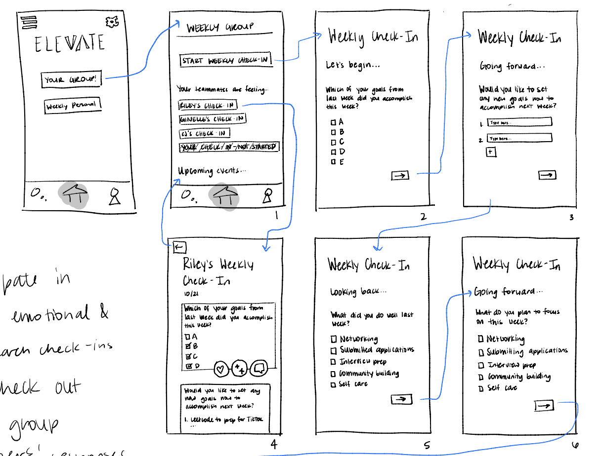
More detailed version of complex check-in task flow – we didn’t end up using this prototype for testing, but may implement some of its elements to address pain points

Slide 54
